Slide 1

A C Primer (3): Flow of Control (ABC Chapter 4)
Ion Mandoiu
Laurent Michel
Revised by M. Khan, J. Shi and W. Wei

Slide 2
Flow of Control
Statements are normally executed sequentially
For selective or repeated execution we have all the usual suspects from Java/C++/Python
blocks
if and if-else
while
for
switch
break
continue

Slide 3
Blocks (compound statements)
{
int a, b;
a = 3;
b = a * 10;
// C99
int c;
c = a * b;
}
List of statements enclosed by { and }
Considered as a single statement
No semicolon after closing }
Can be empty
Can be nested (block in block)
Useful for branching/loop statements
Can define variables at the beginning of blocks
Can mix declarations and code in c99

Slide 4
Comparison and logical operators
Comparison operators that compare two expressions
Pay attention to types!
== != > < >= <=
Logical operators
&& || !
The result is either 0 or 1 (of int type)
Again, 0 means false and 1 means true
See the textbook for precedence and associativity

Slide 5
Branching: if and if-else
if (<exp>)
<stmt>
if (<exp>)
<stmt1>
else
<stmt2>
exp
exp
exp is zero
exp is zero
exp is nonzero
exp is nonzero
stmt
stmt1
stmt2
“exp” is typically a comparison or logical expression, but can be ANY expression (float/double, pointer, …)
The statements can be compound statements (blocks)
Or other if statements!
Beware of the dangling else (“else” matches the nearest preceding “if”, use blocks to disambiguate)

Slide 6
Example: min
int i, j, min;
if (i < j)
min = i;
else
min = j;
// Indentation is not required, above 4 lines are the same as
if (i < j) min = i; else min = j;

Slide 7
Example: if-else statement with blocks
int i, j, k;
if (i < j) {
k = i;
printf("i is selected.\n");
} // no ; here
else {
k = j;
printf("j is selected.\n");
}

Slide 8
Ternary operator
Takes three expressions as operands
exp1 ? exp2 : exp3
exp1 is evaluated first
If exp1 is non-zero (true), exp2 is evaluated and its value is used as the value of the ternary expression
If exp1 is zero (false), exp3 is evaluated and its value is used as the value of the ternary expression
Example:
min = i < j ? i : j;

Slide 9
While Loop
while (<exp>)
<stmt>
Example: computing sum of 0..99
int i = 0, sum = 0;
while (i < 100) {
sum = sum + i;
i++;
}
// Same as
while (i < 100) sum += i++;
exp
exp is zero
exp is nonzero
stmt

Slide 10
Do-While Loop
Checks condition after executing loop body
The statement is executed at least once
do
<stmt>
while (exp);
Example: computing sum of 0..99
stmt
int i = 0, sum = 0;
do {
sum = sum + i;
i++;
} while (i < 100);
exp
exp is nonzero
exp is zero

Slide 11
For Loop
for( <exp1>; <exp2>; <exp3>)
<stmt>
Sometimes called “counting” loop
More like swiss-army knife!
Three expressions:
Initialization, condition, increment
Equivalent to
eval exp1
exp2
exp2 is zero
exp1;
while (exp2) {
<stmt>
exp3;
}
exp2 is nonzero
stmt
eval exp3
Notes:
for (;;) is an infinite loop.

Slide 12
Computing sum of 0..99 using for
int i, sum;
// one way
sum = 0;
for (i = 0; i < 100; i++) sum = sum + i;
// another way, with all initializations inside
for (sum = i = 0; i < 100; i++) sum += i;
// yet another way, with empty body
for (sum = i = 0; i < 100; sum += i++);
// yet another, using comma operator
for (sum = 0, i = 0; i < 100; sum += i, i++);

Slide 13
Comma operator
Takes two expressions
exp1 , exp2
exp1 is evaluated first, then exp2 is evaluated
exp2 is the result of the whole expression
Has the lowest precedence
Associates from left to right
exp1, exp2, exp3 ⬅➔ (exp1, exp2), exp3
Order can make a difference, e.g.,
for (sum = 0, i = 0; i < 100; sum += i, i++);
is not the same as
for (sum = 0, i = 0; i < 100; i++, sum += i);

Slide 14
Multyway branching using “else if” …
// Assume all variables are defined as int
…
if (i == 0)
n0++;
else if (i == 1)
n1++;
else if (i == 2)
n2++;
else
n_other++;

Slide 15
Switch
Also called “selection” statement
switch (<integer expression>) {
case <integer constant1>:
<statements>
case <integer constant>:
case <integer constant>:
<statements>
default:
<statements>
}

Slide 16
Switch example
// Assume all variables are defined as int
switch (i) {
case 0:
n0 ++; break; // Note the break statement
case 1: // No break for case 1. Will continue.
case 2:
{ // Can put a block here and define new variables
int a = d + 10;
n1 = a * 10; break; }
default:
n_other ++;
}

Slide 17
Break Statement
Most commonly used in switch statements
Prevents “fall-through” to the next case
Also works in loops (for, while, do-while)
Loop execution terminated immediately, control resumes at statement immediately following the loop
switch (a) {
…
break;
…
} // end of switch
…
{ // begin loop body
…
break;
…
} // end loop body
…

Slide 18
Continue Statement
Skip the rest of current loop iteration and continue to the next one
Can be used within for, while, and do-while loops
Can appear in a nested if / else
If used in nested loops, it applies to the “innermost” enclosing loop
For “for” loops, go to the evaluation of the “increment” expression
{ // begin loop body
…
continue;
…
} // end loop body

Slide 19
Study the remaining slides yourself

Slide 20

Operators so far
Most
Least

Slide 21
Shortcut evaluation of logical expressions
For expressions that contain logical operators && and ||, the evaluation stops as soon as the outcome true or false is known:
exp1 && exp2
// Evaluate exp1. If false, exp2 is not evaluated.
exp1 || exp2
// Evaluate exp1. If true, exp2 is not evaluated.
Makes it safe to write code like
if (a != 0 && c == b/a) … // no divide by 0 error

Slide 22
Avoid these common pitfalls
Confusing assignments and tests for equality
x=8 vs. x==8
Off by 1 errors in counting loops
for (int i=0; i <= n; i++) …
Confusing logical and bitwise ops
x && y vs. x & y
Forgetting the "break" statements in a switch
Dangling else in nested if-then-else

Slide 23
Dangling else
if (a) if (b) s1++; else s2++; // Avoid this
// which 'if' is 'else' associated with?
if (a) {if (b) s1++; else s2++;} // option 1
if (a) {if (b) s1++;} else s2++; // option 2
// C chooses option 1

Slide 24
Comparing if-then in C and Python
Indentation carries no information in C
Block structure is explicit, using { }
Condition must be in parentheses
C version
Python version
if (n==0) return 1; else return n*fact(n-1);
// Easier to read
if (n == 0)
return 1;
else
return n * fact(n - 1);
if n==0:
return 1
else:
return n * fact(n-1)

Slide 25
Declaring variables in “for” (C99)
// C99 allows variable declarations in init expression
// i lives in the loop. It is undefined after the loop
int sum = 0;
for (int i = 0; i < 100; i ++)
sum += i++;

Slide 26
Example: computing the sum of odd integers
int i, sum;
sum = 0;
for (i = 1; i < 100; i++)
if (i % 2) sum += i;
// (i % 2) is the same as (i % 2 != 0)
// the condition can also be (i & 1)

Slide 27
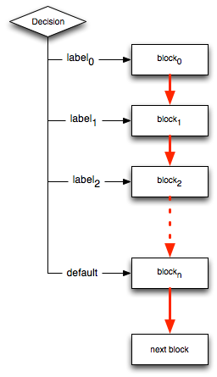
Switching
switch(expression) {
case label0: <block0>
case label1: <block1>
…
default: <blockn>
}

Slide 28
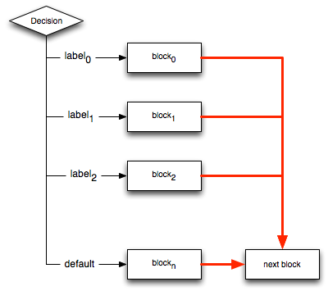
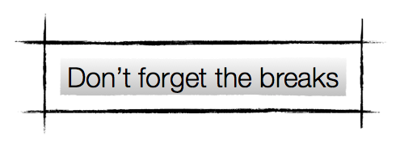
This is usually what you mean
switch(expression) {
case label0: <block0>;break;
case label1: <block1>;break;
…
default: <blockn>
}

Slide 29

The forbidden One: goto
goto <label>;
…
label:
<block>
Forget you ever knew goto existed
This is a terrible control primitive
Don’t ever use it.
Really.
Seriously.
Nothing good will come out of it

Slide 30
Caveat Emptor
Continue and Break…..
Are troublesome fellows
Easy to misuse
Recommendation
Use break with switch
Avoid break within loops
Avoid continue altogether

